Slide 1

MATLAB ASSIGNMENT 2
GROUP 16

Slide 2
GROUP 16 MEMBERS
NO. | STUDENT NAME | REG. NO. | COURSE | SEX | GITHUB LINK
1 | KABWERU ANDREW | BU/UG/2024/5057 | WAR | M | https://github.com/kabweruandrew39-alt/Andrew.git
2 | CHEMONGES MIKIRAR | BU/UP/2024/1005 | WAR | M | https://github.com/Chemonges-mikirar/Chemonges
3 | NAGASHA RITTA | BU/UG/2024/5055 | AMI | F | https://github.com/Nagasharitah/Nagasha-Ritta.git
4 | DIKITAL JOHN | BU/UP/2024/1125 | WAR | M | https://github.com/JOHNDIKITAL/johndikitalmatlab.git
5 | SANYU JOY | BU/UP/2024/5348 | MEB | F | https://github.com/joysanyu22-cell/SANYU-JOY.git
6 | OULE SADOCK | BU/UP/2024/0844 | AMI | M | https://github.com/oulesadock25/Oule-Sadock-.git
7 | WANGUSI DAVID | BU/UP/2024/5350 | MEB | M | https://github.com/wangusid22/WANGUSI-DAVID.git
8 | SEBATIKA COLLINE | BU/UP/2024/0845 | AMI | M | https://github.com/SebyatikaColline/Sebyatika-Colline.git
9 | ATYANG MILDRED | BU/UP/2024/1019 | WAR | F | https://github.com/mildredmoreen/ATYANG-MILDRED-.git
10 | KITUTU LEONARD | BU/UP/2024/1035 | WAR | M | https://github.com/leonardkitutu1-hue/leonard-kitutu.git

Slide 3
INTRODUCTION TO MATLAB
MATLAB, which stands for matrix laboratory, is a high-performance programming language and environment designed primarily for technical computing
The first version of MATLAB was created in Fortran in the late 1970s as a simple interactive matrix calculator. This early iteration was built on top of two significant mathematical libraries: LINPACK and EISPACK, which were developed for numerical linear algebra and eigenvalue problems, respectively.
MATLAB was officially launched as a commercial product in 1984 by MathWorks, a company founded by Moler along with Jack Little and Steve Bangert. The software was reimplemented in C, with the addition of user-defined functions, toolboxes, and graphical interfaces.
Recent versions of MATLAB have introduced features like the Live Editor, which allows users to create interactive documents that combine code, output, and formatted text. This evolution reflects MATLAB's ongoing adaptation to meet the needs of its diverse user base across academia and industry.

Slide 4
question ONE
From assignment 1 question , utilize all knowledge obtained from module 1 -4 to visualize the different parameter, patterns, trends, and relationships. Ensure that each plot is saved as an image and is well annotated and labeled.

Slide 5
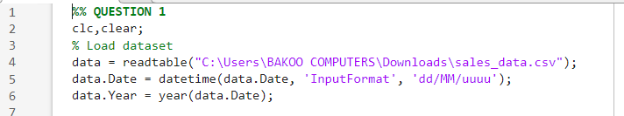
Step1: loading the dataset and changing date format to datetime
We used MATLAB’s inbuilt function “readtables” we loaded the excel file “sales_data.csv” into Matlab and assigned it variable name “data”. We also changed the date format to datetime using the “datetime” function

Slide 6
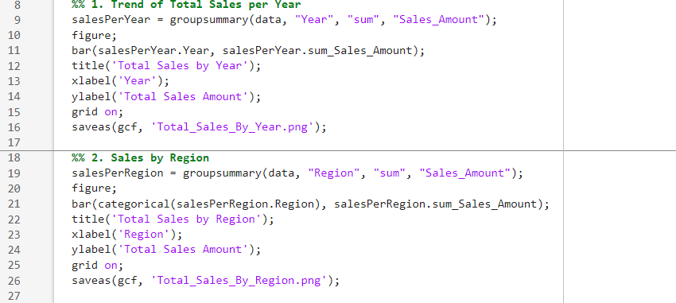
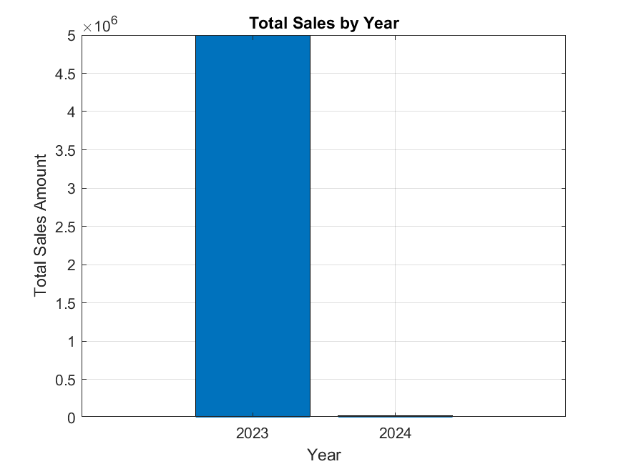
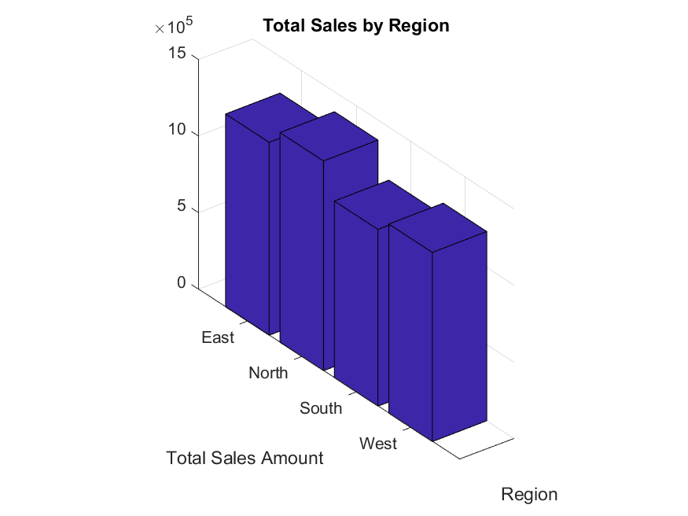
Step 2: writing codes in MATLAB

Slide 7
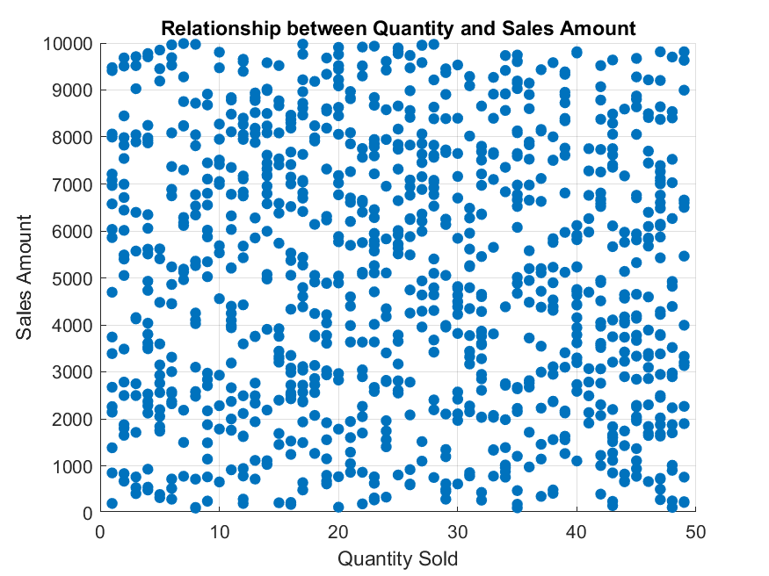
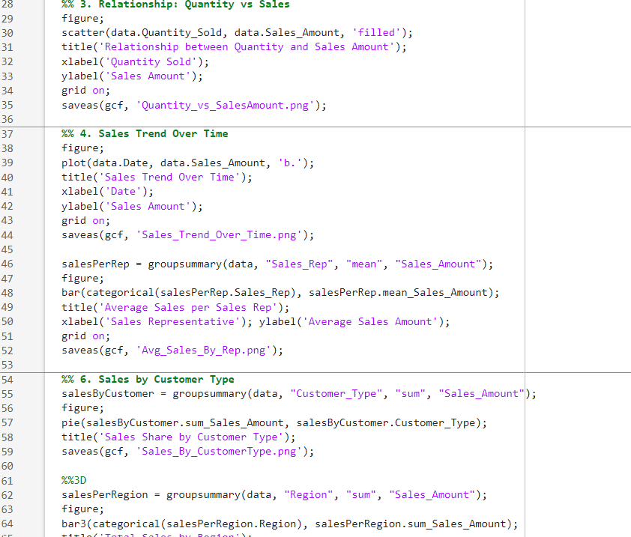
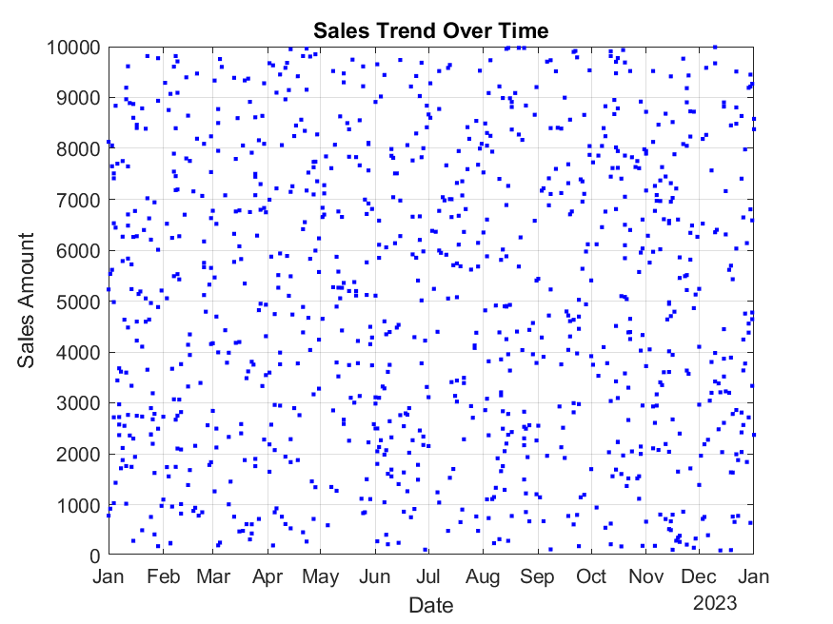
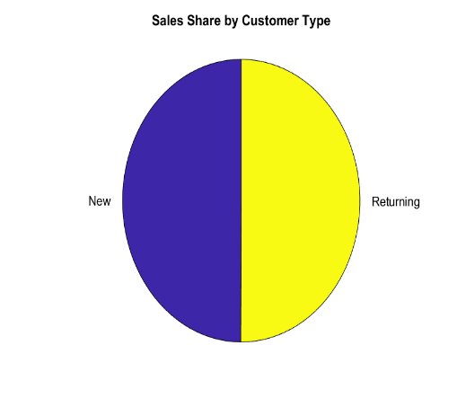
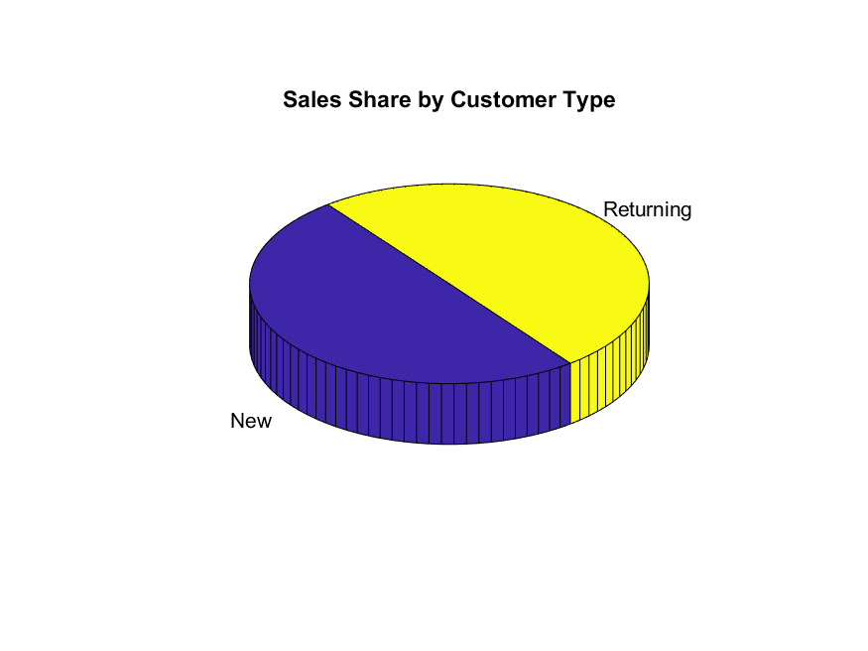

Slide 8
Question 2
From assignment 1 question 2, utilize all knowledge obtained from module 1 -4 to describe the different statistical characteristics in the data and ensure to visualize them. Ensure the different attributes or data collected per individual is detailed enough to describe them

Slide 9

Step1: loading MATLAB file and changing struct2table into table
We used the “load” function to load the Matlab file “Student.mat” into Matlab, we also used “struct2table” functions to change structure to table.

Slide 10
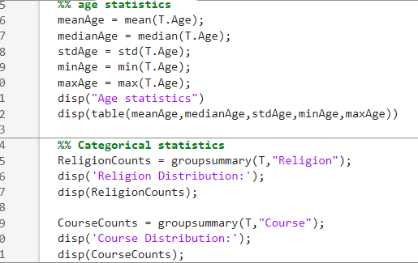
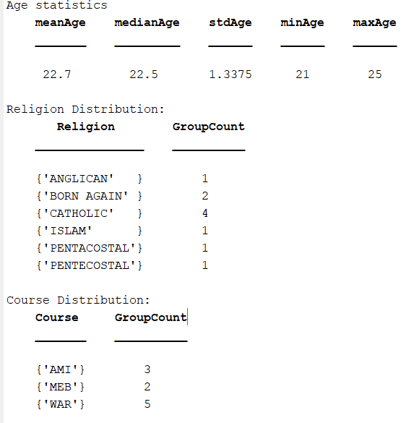
Step two: CODING
From the knowledge of plotting we acquired from module 4, using functions such as “bar”, “groupsummary”, “categorical”, ”pie”, ”grid on”,”bar3”, ”scatter”, ”saveas”, etc, we managed to write codes that plot pie charts, bar graphs, histograms in both 3D and 2D and saved them as images.

Slide 11
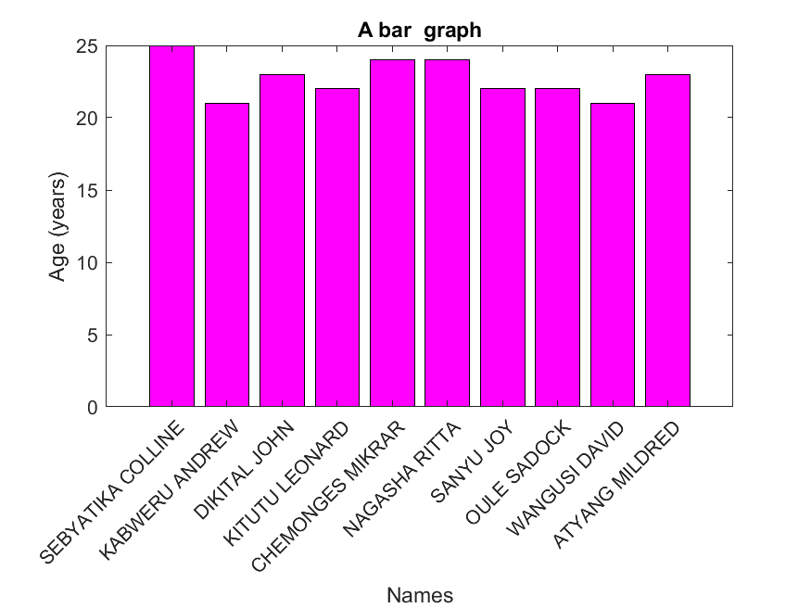
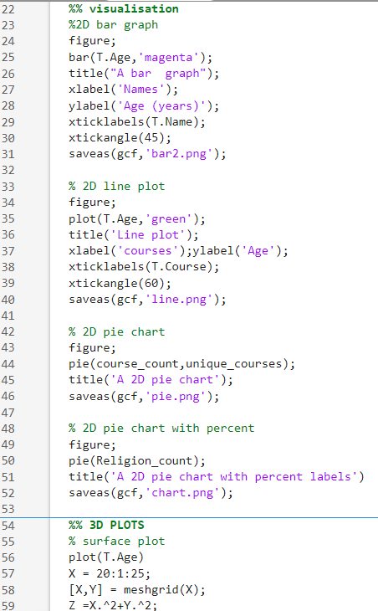
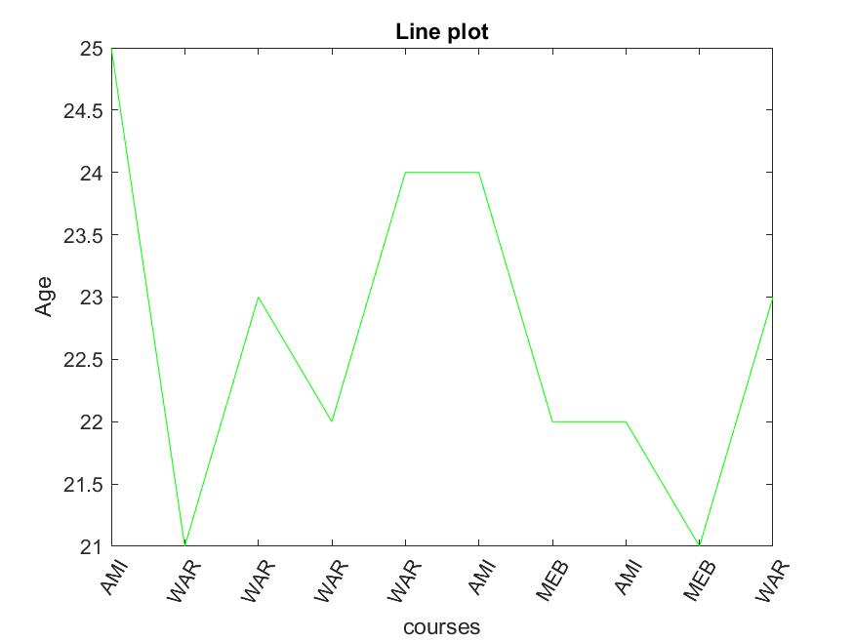
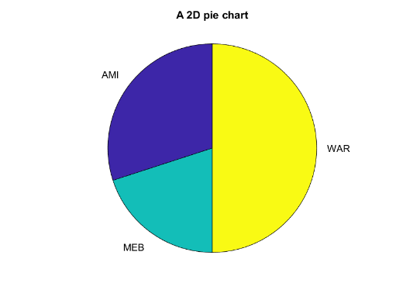
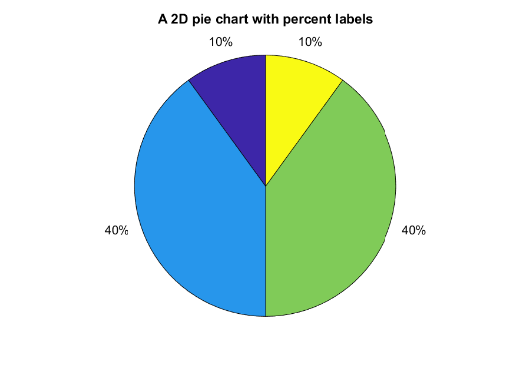
VISUALIZATION

Slide 12
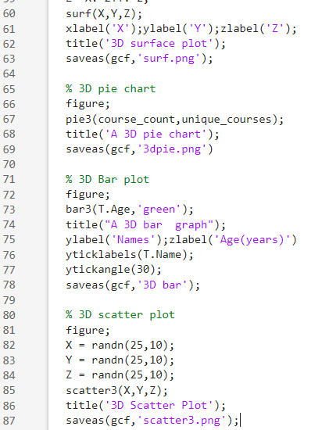
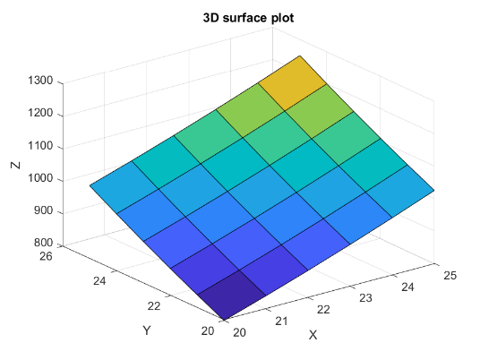
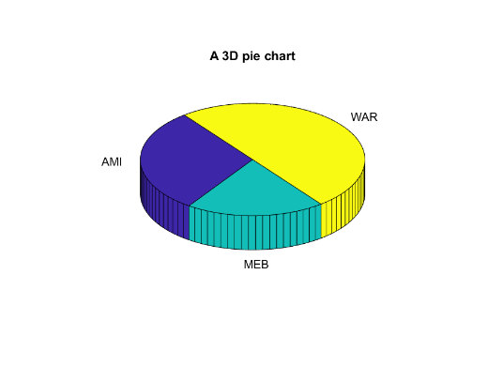
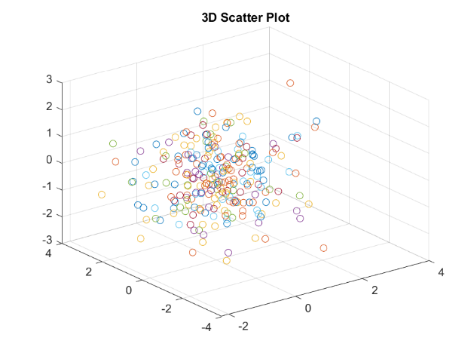

Slide 13
Conclusion:
The study achieved its objectives by analysing the data and presenting meaningful results. The findings highlighted key patterns and demonstrated the importance of teamwork and systematic approaches in producing reliable outcomes.

Slide 14
THANK YOU

